Slide 1
E-Commerce Data Privacy
A Case Study

Slide 2
Model Sources
Models based mainly on a case study of a single paper:
User Agents in E-Commerce Environments: Industry vs. Consumer Perspective on Data-Exchange, Sarah Spiekermann, Ian Dickinson, Oliver Günther, Dave Reynolds.
Ideas on security considerations obtained from other papers (see complete source list).

Slide 3
Current E-Commerce Privacy
“Personal Information has become an economic good”.
Corporations and Privacy Rights Advocates are opposing players, with Consumers as a third party.
Corporations require consumer profiles to achieve one-to-one marketing.
Privacy Rights Advocates fear discriminatory power of consumer data.
Two classes of online corporations:
  Marketers
    Derive profit from selling goods.
  Mediaries
    Offer mediating or support services, derive profits from users fees and targeted advertising.
Consumers want to maintain their privacy.
To receive goods and services consumers often must supply personal information and accept privacy practices of the corporation.

Slide 4
Current E-Commerce Privacy (continued)
Trust is the basis for transactions, the consumer must place trust in the corporation.
Corporations use consumer profiles in different ways:
  Externally
    Used for targeted advertising, selling and sharing customer profiles.
    Targeted advertising can be potentially advantageous to consumers but is seen as in invasion of privacy.
    Selling customer profiles, although revenue producing, can hurt a corporations competitive business advantage and positive corporate image.
  Internally
    Used for service differentiation, product differentiation and price discrimination.
    Corporations use these techniques to increase profit and retain customers, but are seen to violate the privacy of consumers and can lead to discrimination which can be either advantageous or disadvantageous to consumers.
Corporations want as much accuracy as possible in their consumer profiles.

Slide 5
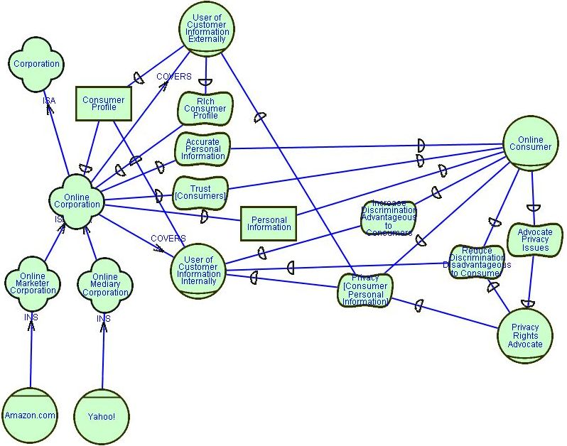
Privacy in E-Commerce SD

Slide 6
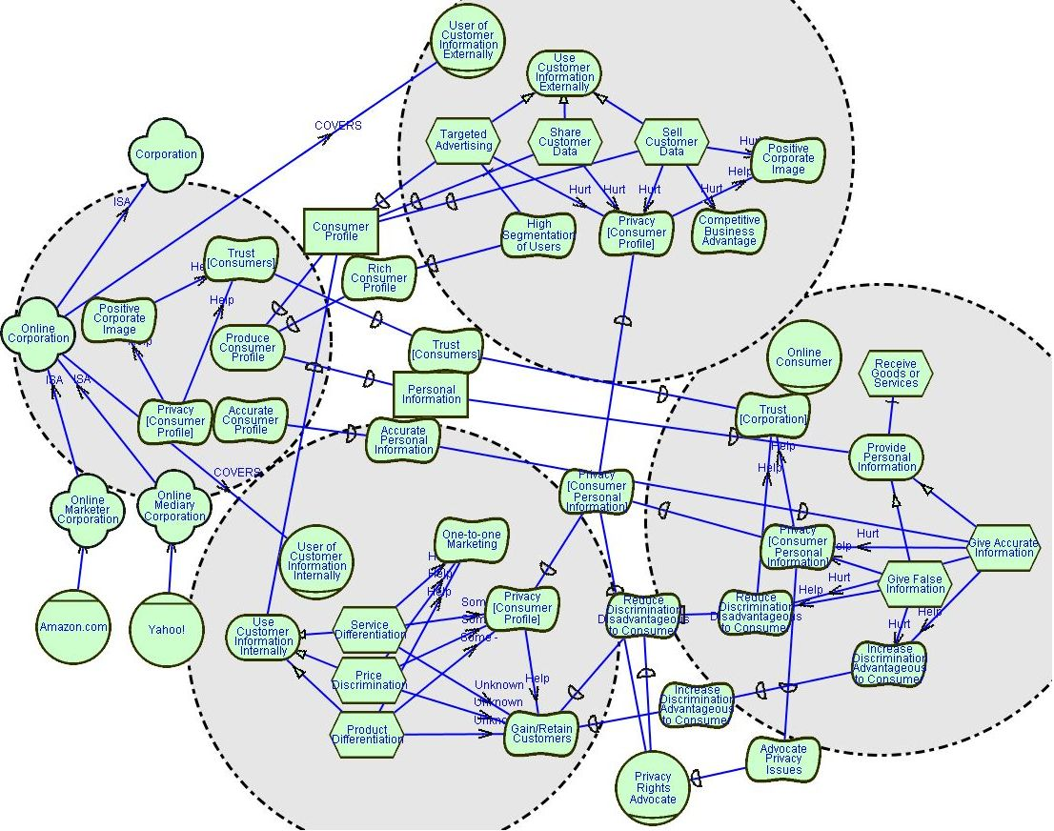
Privacy in E-Commerce SR

Slide 7
E-Commerce Privacy Using Pseudonyms
Pseudonyms protect consumers personal information by giving false information.
Corporations want to address consumers personally to increase perception of service quality.
Consumers can use long-term and short-term pseudonyms.
Long-term pseudonyms can still allow consumers to maintain a personal relationship with corporations.
Short-term pseudonyms impede personalized service.
Pseudonyms create challenges for physical delivery

Slide 8
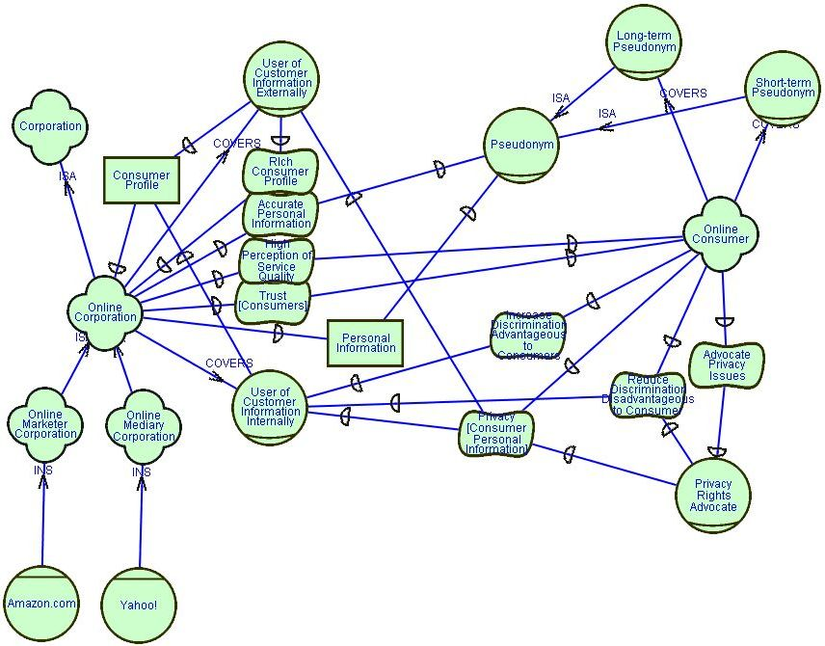
Privacy in E-Commerce Using Pseudonyms SD

Slide 9
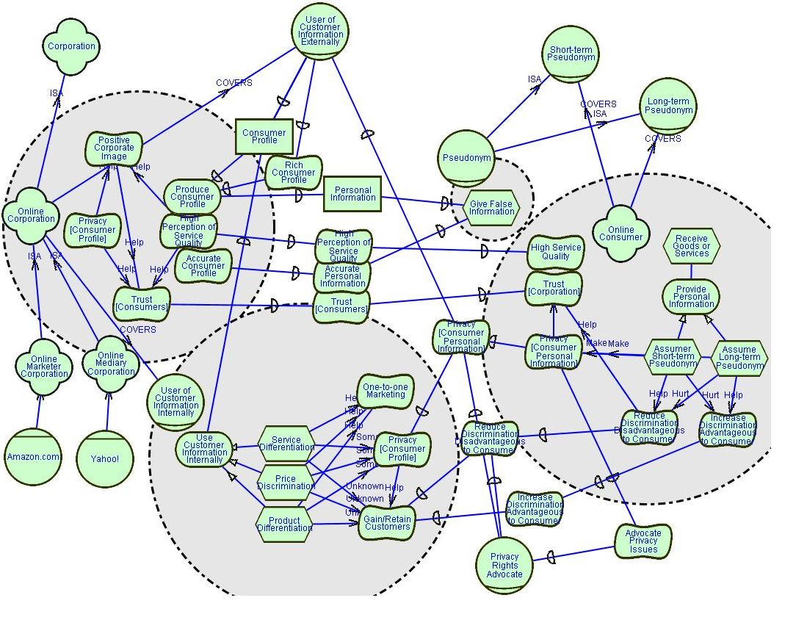
Privacy in E-Commerce Using Pseudonyms SR

Slide 10
Privacy in E-Commerce Using Agents
An agent does client side profiling based only on personal information released voluntarily by the consumer.
Agents manage multiple user identities.
Each identity would contain different levels of information as distinguished by the consumer.
The consumer controls the information that is released to corporations by deciding which identity is used.
Agents acquire metadata about a corporations privacy policy.
Metadata is used by consumers to determine trustworthiness of corporations.

Slide 11
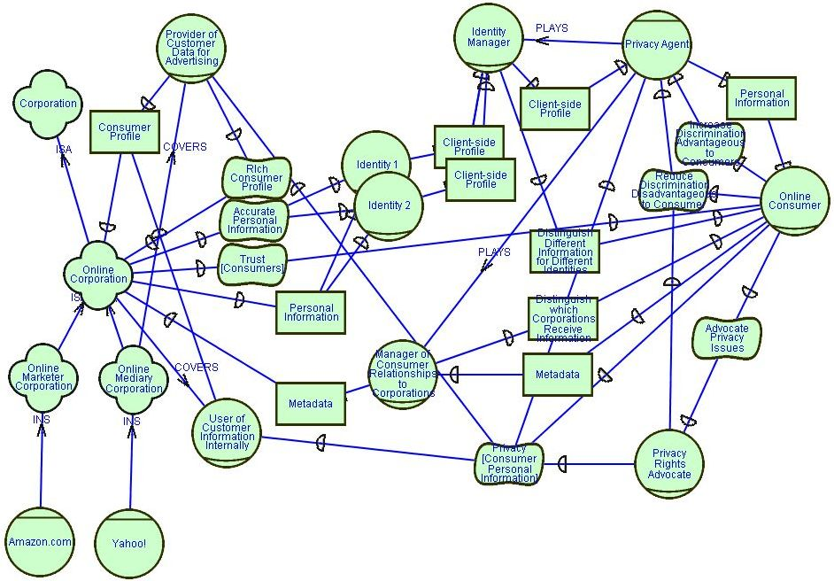
E-Commerce Privacy Using Agents SD

Slide 12
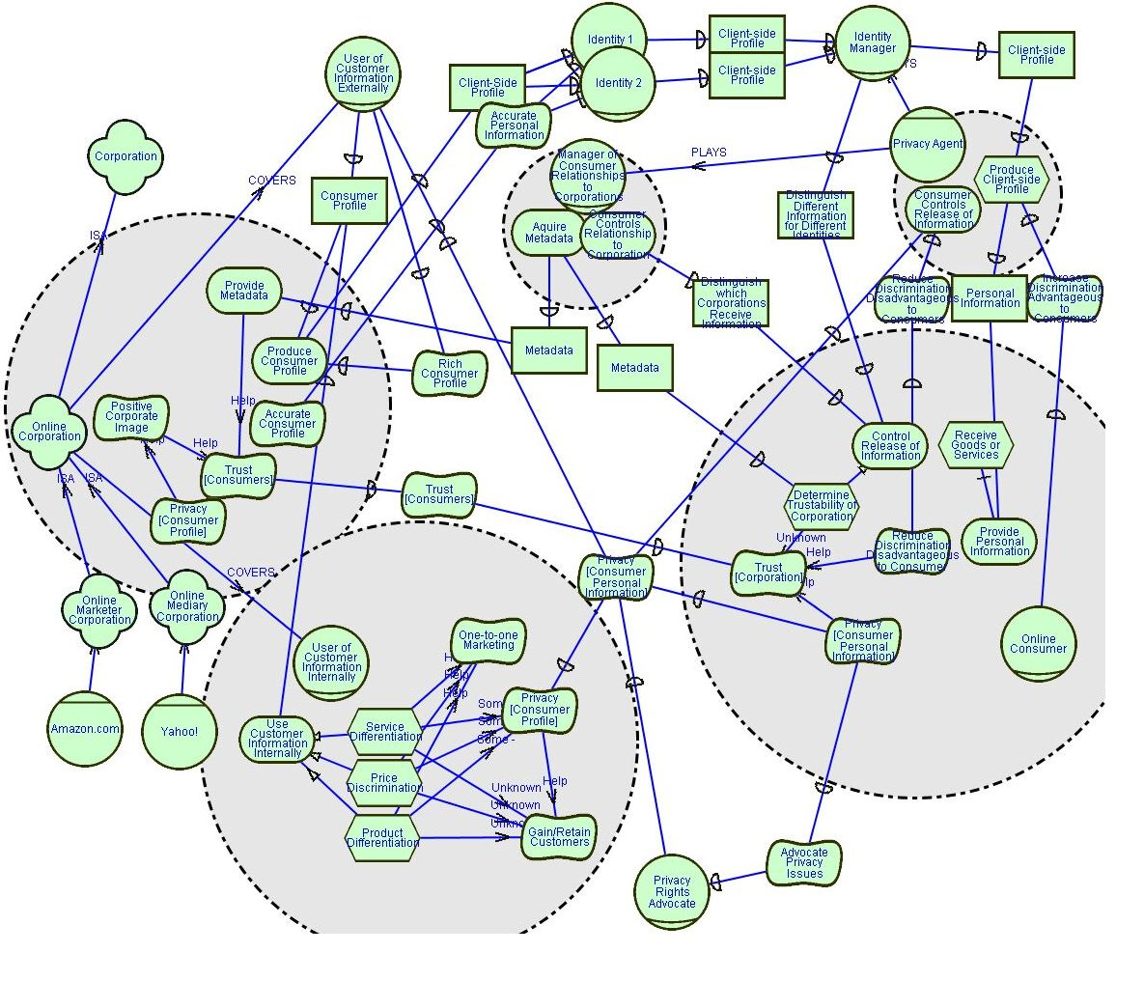
E-Commerce Privacy Using Agents SR

Slide 13
Privacy and Security in E-Commerce
By looking at the representation of security in other papers security can also be considered in this example:
Consumers depend on the privacy agent to keep personal information secure.
Consumers depend on online corporations to keep their consumer profile secure.

Slide 14
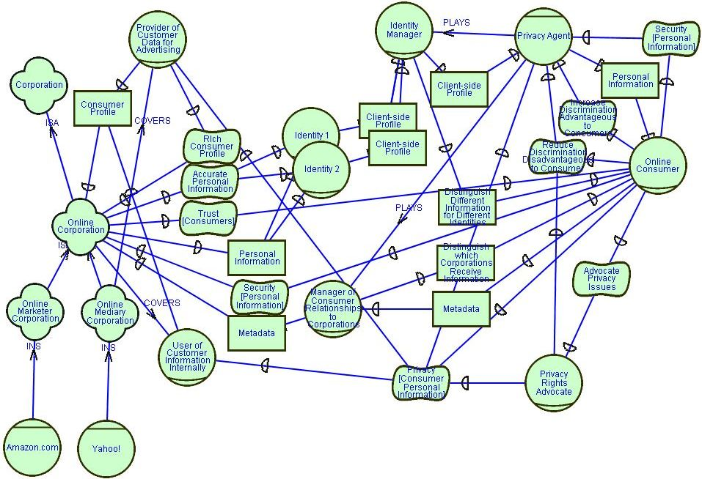
E-Commerce Privacy and Security Using Agents SD

Slide 15
Conclusions
The models can help support the same conclusions drawn in the paper:
The current E-Commerce Privacy situation is flawed in that the consumer and privacy advocates are almost totally reliant on corporations to protect their privacy.
Using Pseudonyms helps consumers to retain their privacy but hurts the corporation’s desire for accurate information, as well as creates challenges for physical delivery.
Using Agents moves the consumer’s dependencies for privacy and positive discrimination from the corporations to the agents, by allowing the agent to control release of information. As agents act based on decisions made by the consumer themselves this appears to be a potential solution to E-Commerce privacy issues.

Slide 16
References
User Agents in E-Commerce Environments: Industry vs. Consumer Perspective on Data-Exchange, Sarah Spiekermann, Ian Dickinson, Oliver Günther, Dave Reynolds.
[RE03] Security and Privacy Requirements Analysis within a Social Setting, Lin Liu, Eric Yu, John Mylopoulos.
[SREIS02-Priv] Designing for Privacy and Other Competing Requirements, Eric Yu, Luiz Marcio Cysneiros.
[ER01] Modeling Strategic Actor Relationships to Support Intellectual Property Management, Eric Yu, Lin Liu, Ying Li.
[SREIS02-Sec] Analysing Security Requirements As Relationships among Strategic Actors, Lin Liu, Eric Yu, John Mylopoulos.
[TrustCh01] Modelling Trust for System Design Using the i* Strategic Actors Framework, E. Yu, L. Liu.

